Slide 1
Shell Bootcamp 2024 3 Reflections for Week 3
Rashi Agarwal
Date : 14-Sept-2024

Slide 2

About Me
“Do the best you can until you know better. Then when you know better, do better.”
- Maya Angelou
Please share an image / visual that best represents you

Slide 3

My learnings from this week! – Advanced Technical skills
WEEK - 3

Slide 4
Learning 1 | My takeaways
Please share (in your own words) details of the learning.
Creating VM on Azure
Azure Virtual Machines (VMs) are a versatile and scalable computing resource offered by Microsoft Azure. They allow you to run applications and workloads in the cloud without the need to invest in and maintain physical hardware. Here are some key features and benefits:
Flexibility: You can choose from a wide range of VM sizes and configurations to match your specific needs, whether you’re running a small application or a large-scale enterprise solution1.
Cost Efficiency: Azure offers various pricing options, including pay-as-you-go, reserved instances, and spot VMs, which can help you optimize costs1.
Scalability: With Azure Virtual Machine Scale Sets, you can automatically scale your VMs up or down based on demand

Slide 5
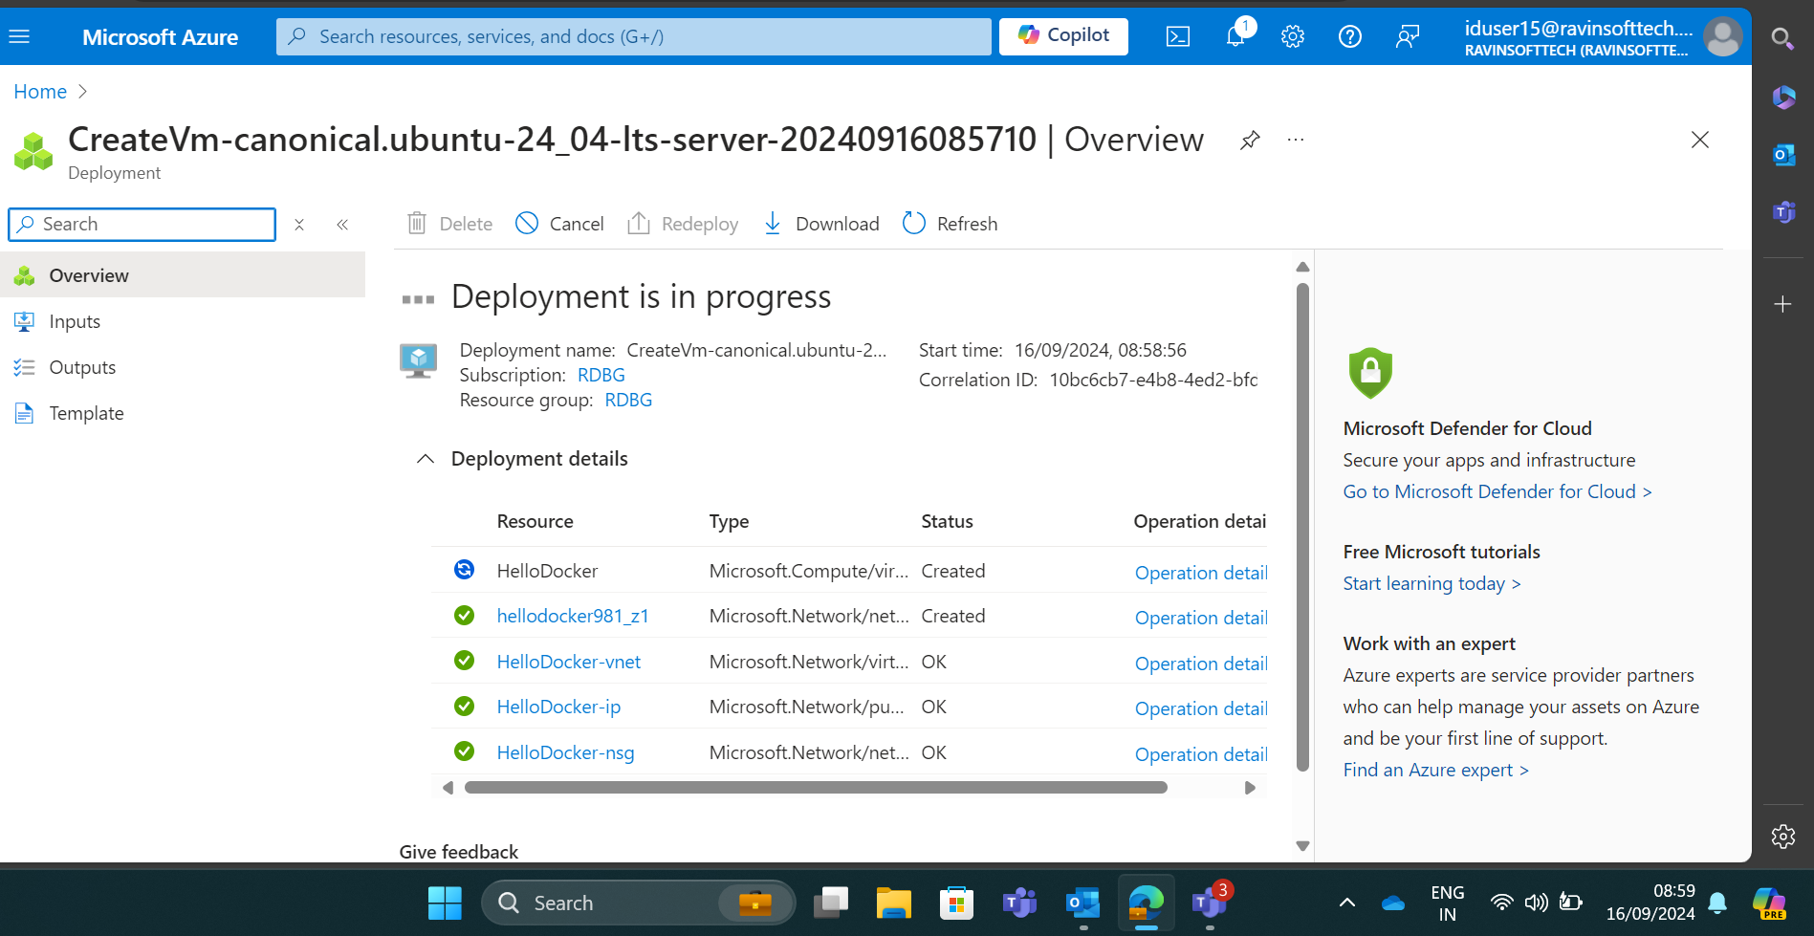
Deploying VM on Azure

Slide 6
Learning 2 | My takeaways
Please share (in your own words) details of the learning.
Docker and Containers
Understanding Docker Basics: I learned how to create a Dockerfile, which is a script containing instructions on how to build a Docker image.
Building a Docker Image: I saw how to use the docker build command to create a Docker image from a Dockerfile.
Running a Docker Container: I learned how to run a Docker container using the docker run command, making my NGINX server accessible on a specified port.
Custom Configuration: I created a custom NGINX configuration file to tailor the server’s behavior to my needs.
Port Mapping: I understood how to map ports from the host machine to the Docker container, allowing external access to the NGINX server.

Slide 7
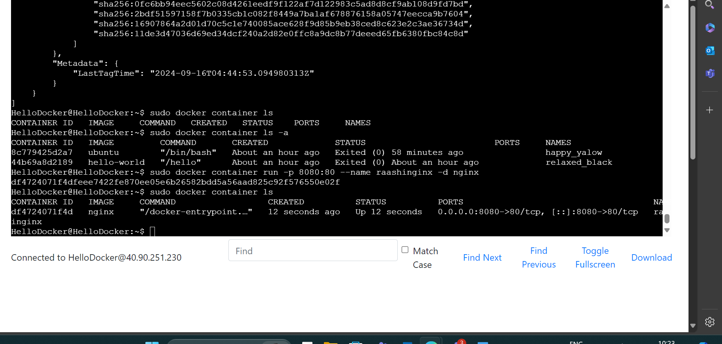
Building Nginx image on SSH

Slide 8
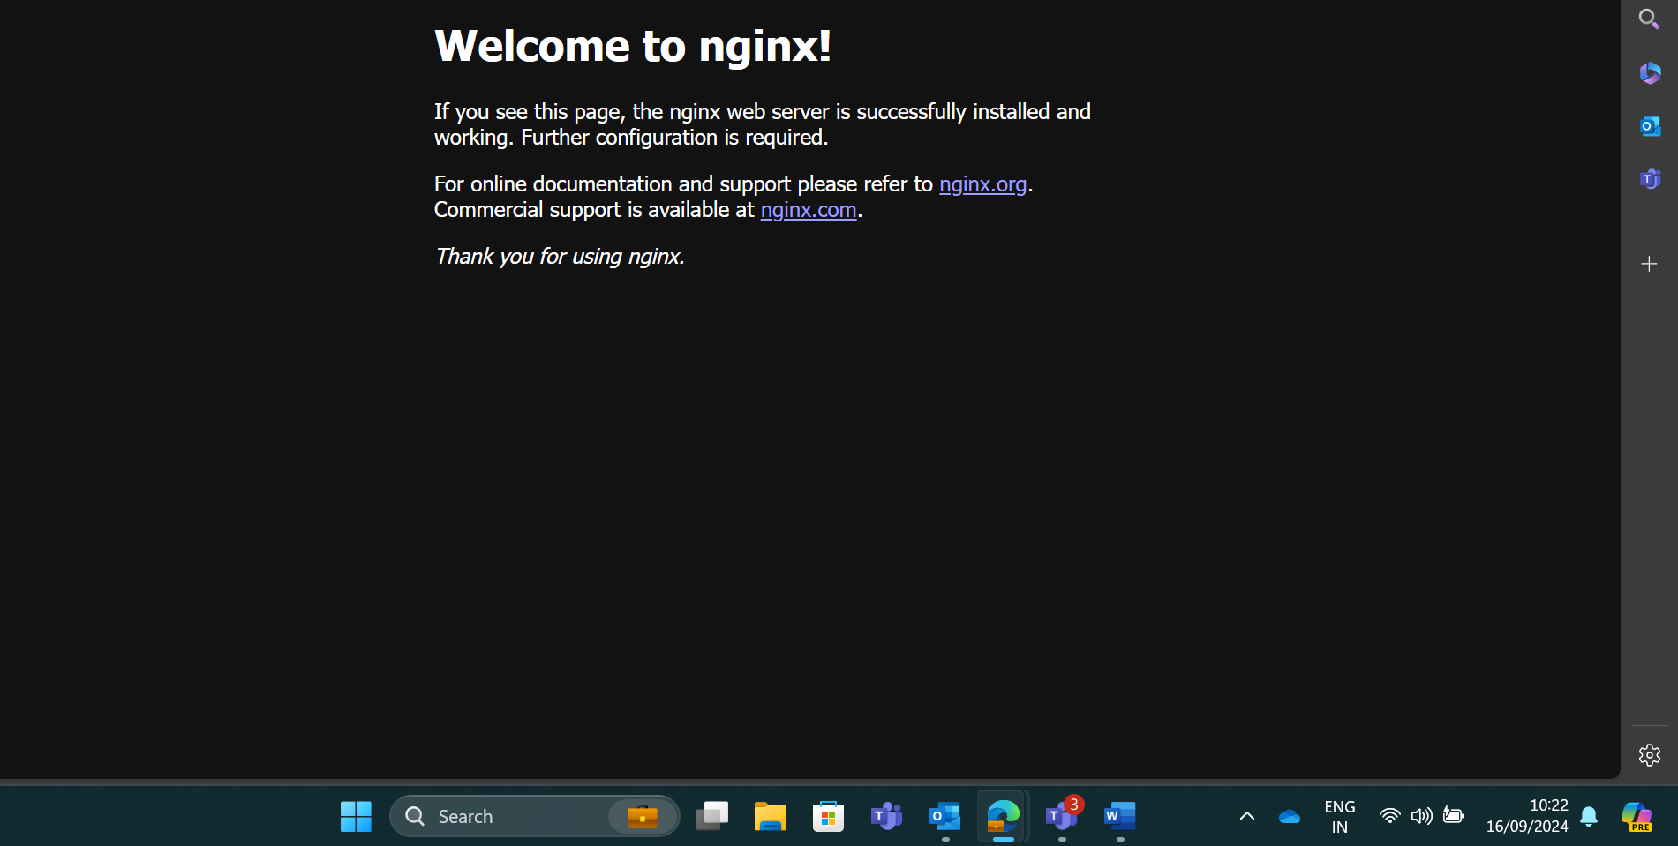
Executing Nginx container

Slide 9
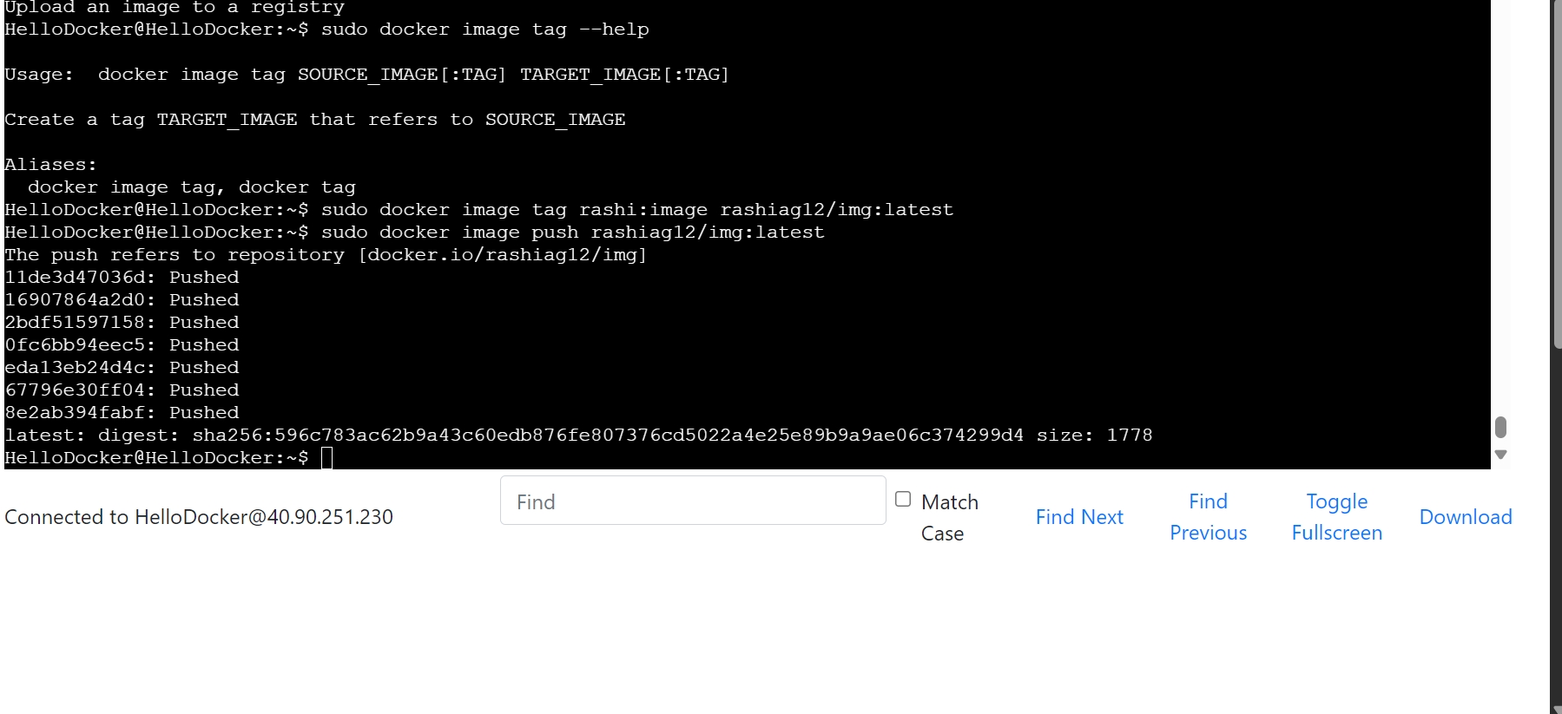
Pushing Nginx image in DockerHub

Slide 10
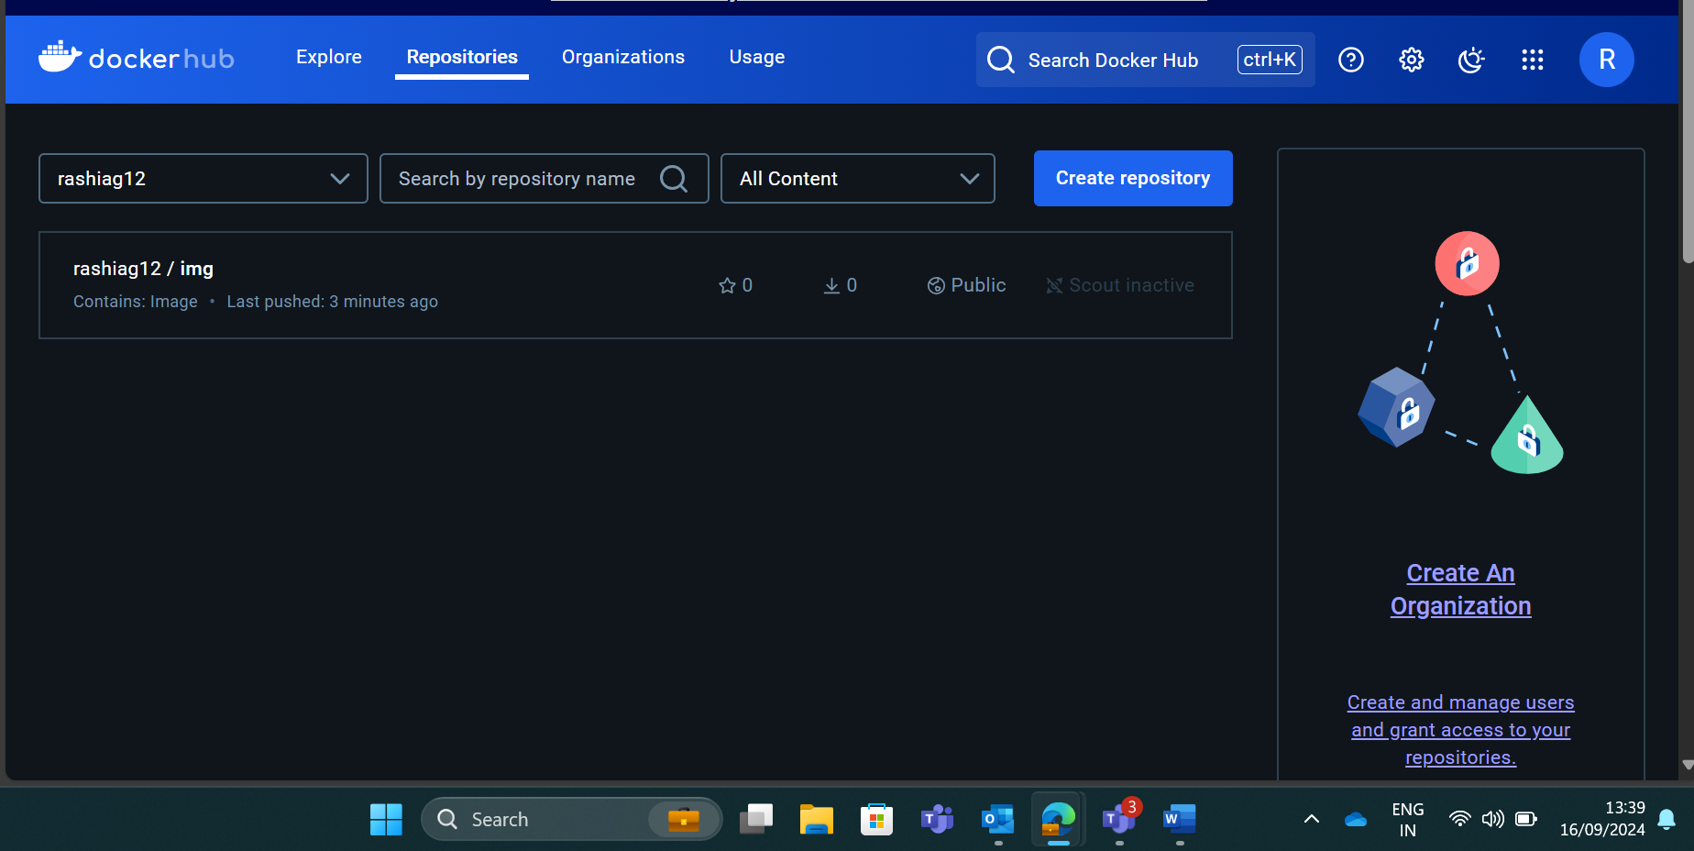
Image pushed into DockerHub

Slide 11
Learning 3 | My takeaways
Please share (in your own words) details of the learning.
Prometheus
Docker Image Management: I learned how to pull a Docker image from Docker Hub using the docker pull command.
Running Containers: I saw how to run a Docker container with the docker run command, making Prometheus accessible on a specified port.
Port Mapping: I understood how to map ports from the host machine to the Docker container, allowing me to access Prometheus via http://localhost:9090.
Custom Configuration: I learned how to mount a custom configuration file into the Docker container using the -v option.

Slide 12
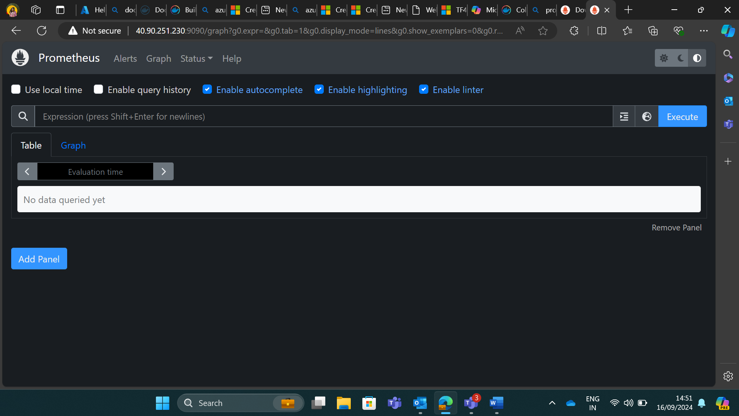
Executing Prometheus on Browser

Slide 13
Thank You

